Slide 1



GI – PEDS

Slide 2
GERD
The GI tract of a child is the LAST to fully develop.
Babies frequently have GERD
May happen 30 or more times a day
Improves with time
These babies are known as “happy spitters”

Slide 3
Pyloric Sphincter
3-6 weeks old
Projectile vomiting
Hungry vomiter
More common in boys

Slide 4
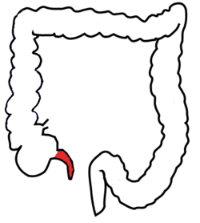
Appendicitis
Anorexia
Periumbilical pain
Migration to RLQ
Pain with movement
Vomiting
Fever
RLQ tenderness
CAREFUL ABDOMINAL EXAM IS KEY IN PEDIATRIC APPENDICITIS
This Photo by Unknown Author is licensed under CC BY-SA

Slide 5
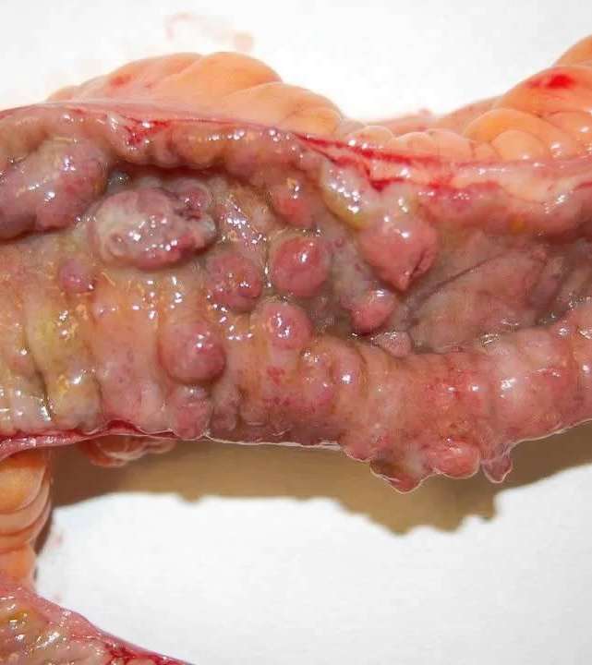
Crohns
Peak incidence between 15 and 30 years of age
5-10% develop their IBD in childhood or adolescence.
GI symptoms: loos stools, bloody diarrhea, abdominal pain , tenesmus
Growth failure ( in height, weight, pubertal delay)
Abdominal tenderness especially in RLQ , perianal disease ( fistulae, anal skin tags, or fissures, occult blood in stool)
This Photo by Unknown Author is licensed under CC BY-NC-ND

Slide 6
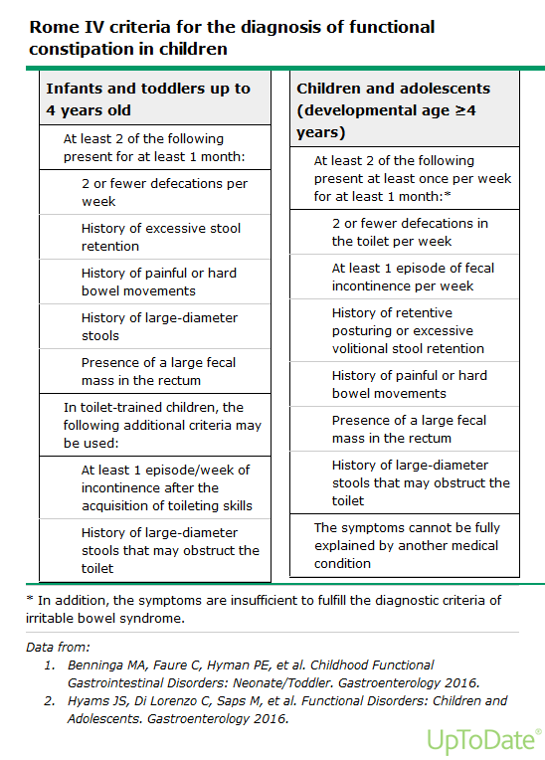
Constipation
Normal for a breast-fed baby to take up to a week for a bowel movement or they can stool every day even every meal.
Stool withholding
Inadequate Fiber
Excessive cows milk
Not enough Water

