Slide 1



Head, Neck, Lymphatics – Peds

Slide 2
Plagiocephaly
Asymmetry and Twisted condition of the head
Sutures allow infants head to reshape during and after birth process and accommodate rapidly expanding brain.
Some molding of skull during birth process is normal but should normalize by 3 weeks of age
Infant brain grows rapidly during first several months after birth

Slide 3
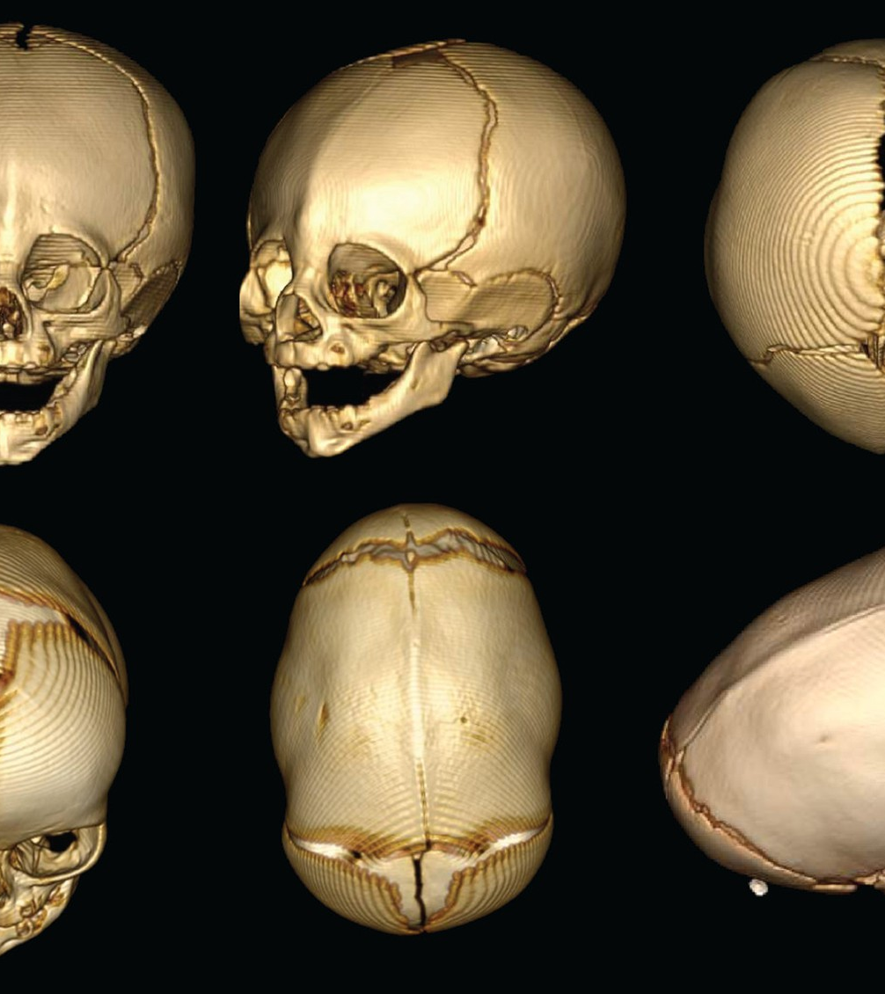
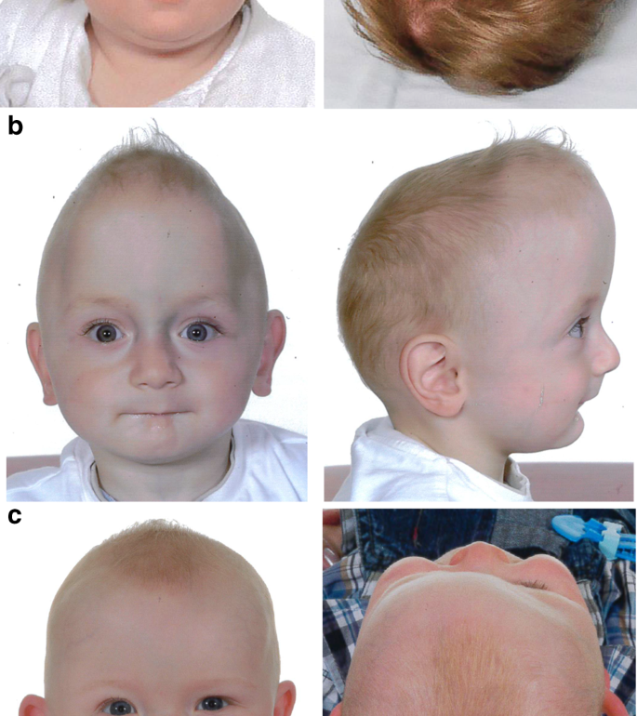
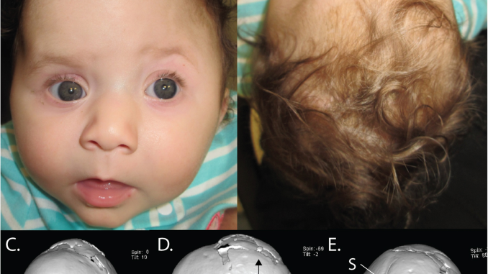
Craniosynostosis –
Premature closure of one or more cranial sutures
Important to recognize craniosynostosis or positional molding early so appropriate intervention can take place
This Photo by Unknown Author is licensed under CC BY
This Photo by Unknown Author is licensed under CC BY

Slide 4
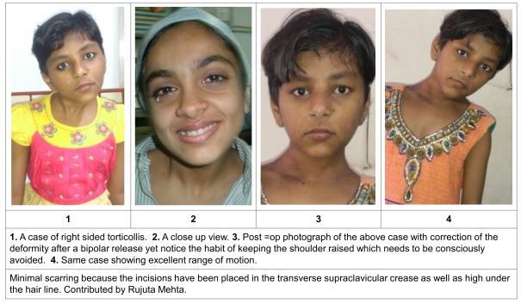
Neck
Torticollis
Can happen suddenly
Usually results from a sternocleidomastoid muscle spasm or trapezius muscle injury
** retropharyngeal abscess- common between 2-4

Slide 5
Get good history
How old is the child?
When did it develop?
How long has it been present
Was it acute onset or insidious
Trauma?\Fever
Recent neck infection?
Associated symptoms vomiting, HA , neurologic deficit, ataxia
New medications?

Slide 6
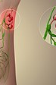
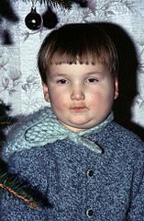
Persistent Lymphadenopathy
No signs or symptoms of sore throat
Persistent swollen lymph nodes
Get CBC and peripheral smear
CT of chest
This Photo by Unknown Author is licensed under CC BY-SA
This Photo by Unknown Author is licensed under CC BY-SA

