Slide 1


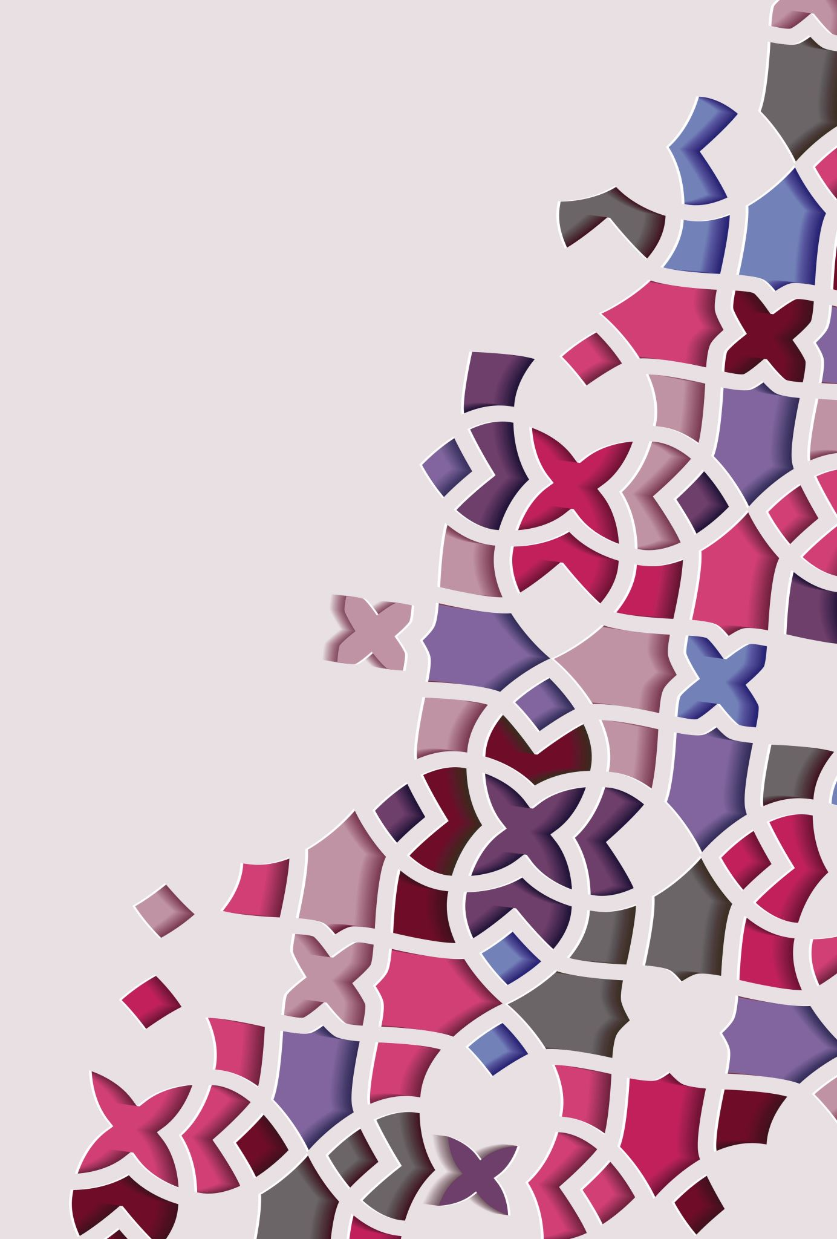
Orhto– PEDS

Slide 2
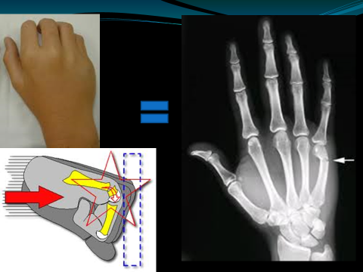
Boxer Fracture
Common in Young adults
This does not occur from a FALL!

Slide 3
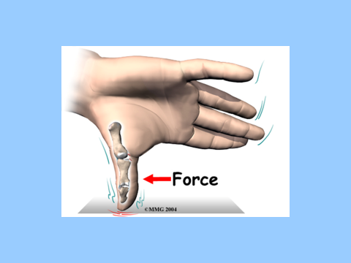
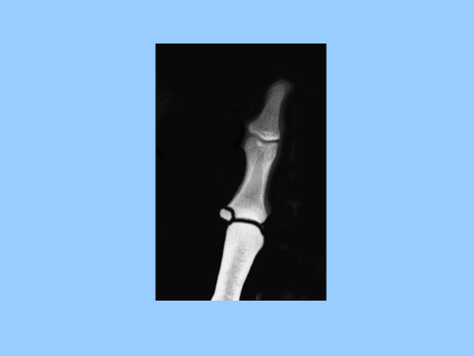
Gamekeepers THUMB

Slide 4
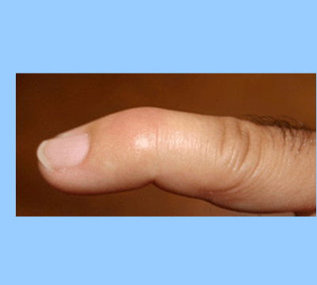
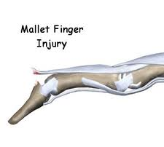
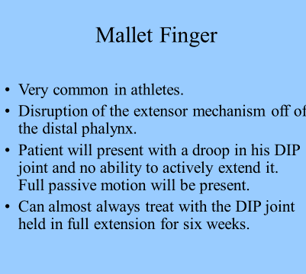

Slide 5
Hip Dysplasia
Abnormal development of the acetabulum and proximal femur and mechanical instability of the hip joints.
Newborns typically can have this but it will normally resolve.

Slide 6
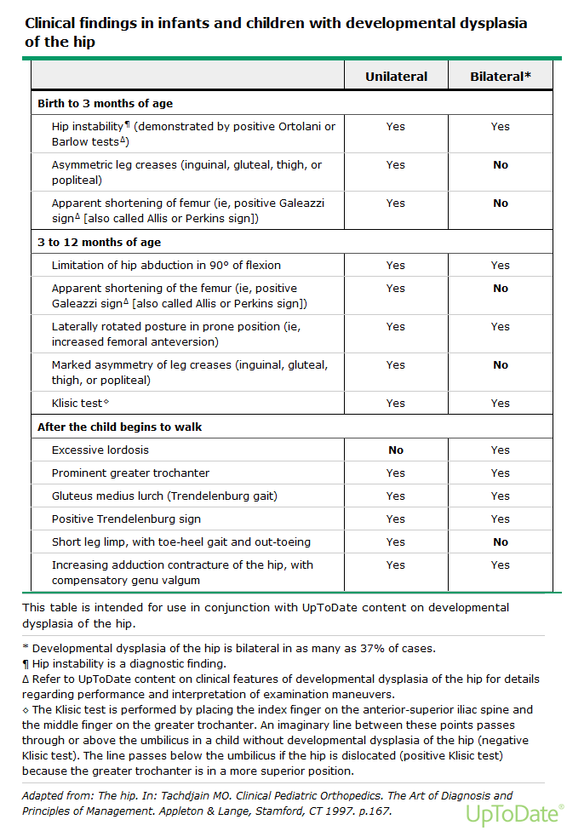
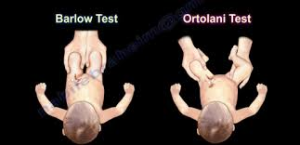

Slide 7
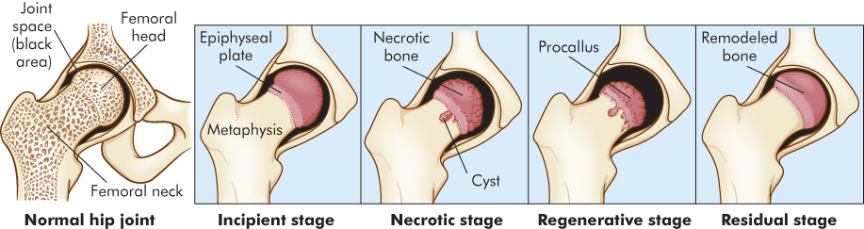
Leg Calvin Perthes
Pain can be in the knee
Groin
Weightbearing
In the absence of activity
NEED FROG LEG XRAYS

Slide 8
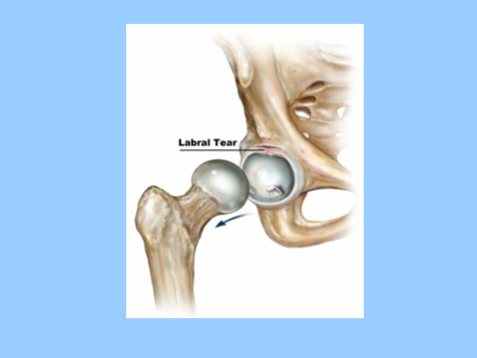
Labral tear – common in dancers

Slide 9
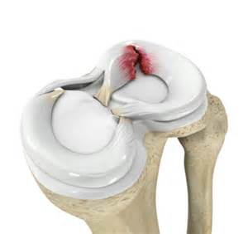
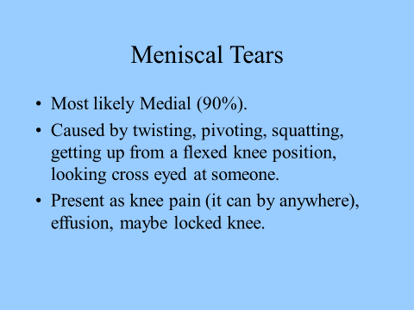

Slide 10
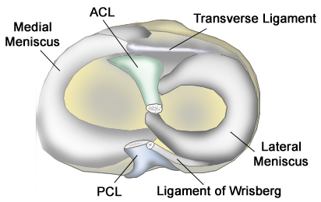
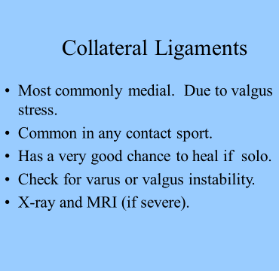

Slide 11
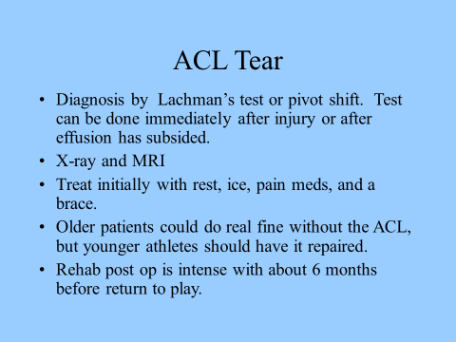
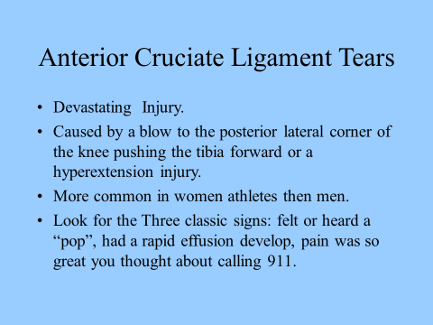

Slide 12
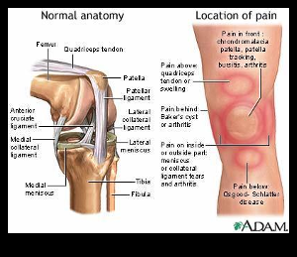
Osgood Schlatter
Typically 13-14-year-old boy
11-12-year-old girl
Recently undergone a rapid growth spurt
c/o anterior knee pain – low grade ache to a limp that impairs activity

Slide 13
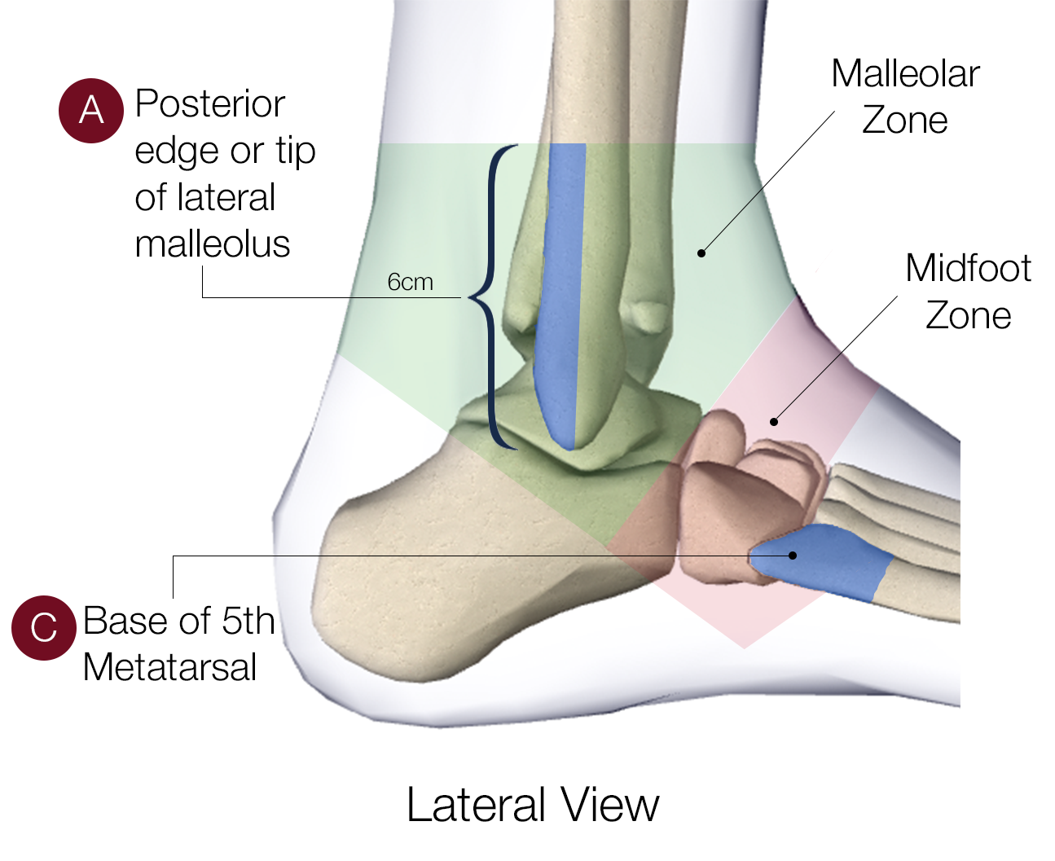
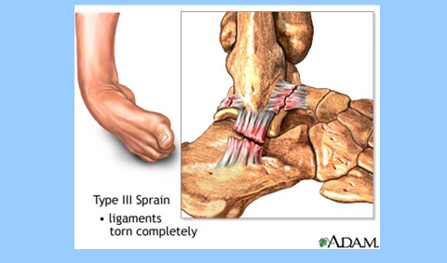
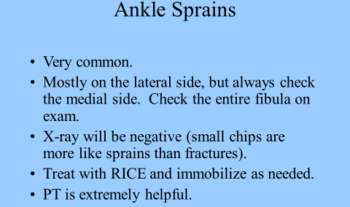

Slide 14
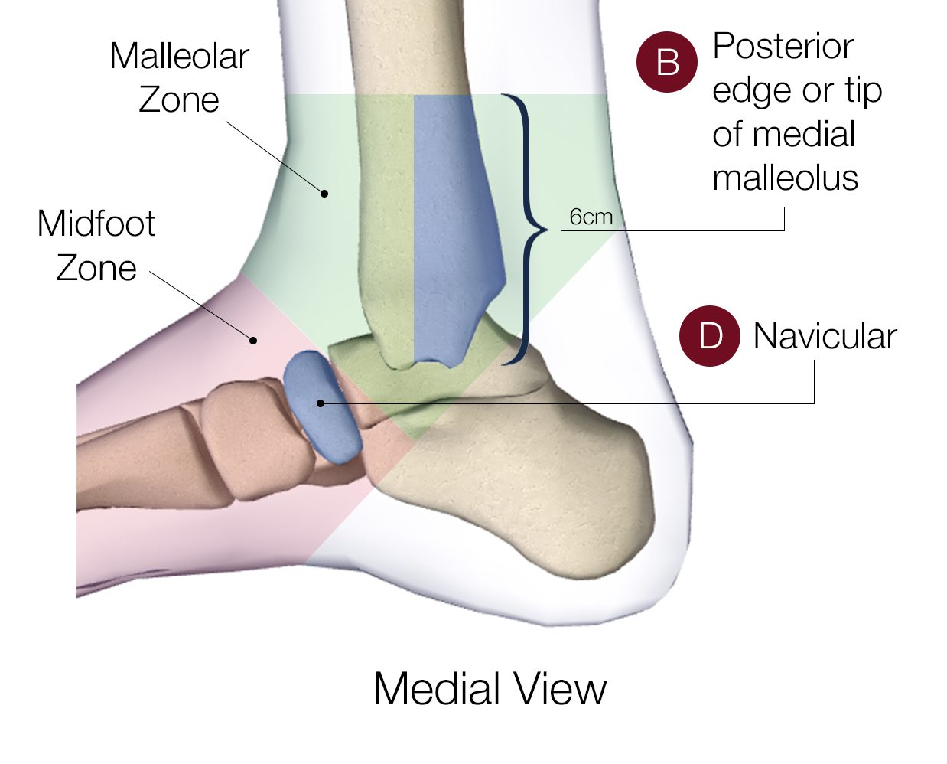
Ottawa ankle rules
Ankle Xray needed if A or B tender or inability to bear weight both immediately and in ER4 steps
Foot Xray needed if C or D or
An inability to bear weight both immediately and in the ER for four steps
http://www.theottawarules.ca/ankle_rules

Slide 15
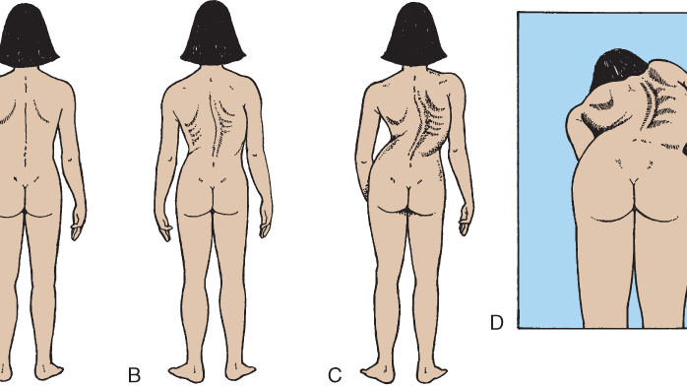
Scoliosis
Found during school-based assessment usually

Slide 16
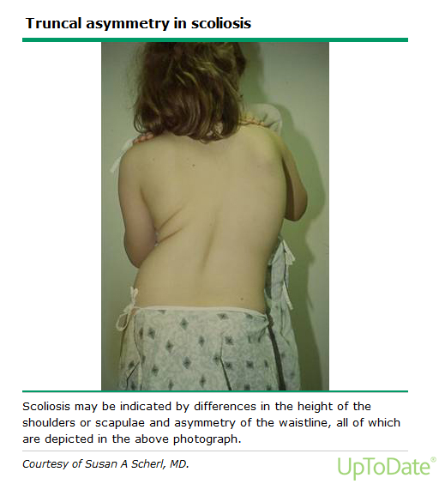
When was deformity first noted
Wat is the rate of progression
Do you have back pain
Are there symptoms suggestive of a neuromuscular condition
Do you have SOB
What is patient's growth chart and when did pubertal growth spurt begin?
Has patient entered puberty?
For female patients has menarche occurred ( girls will grow 24 months post menarche)
For male patient shas shaving started ( skeletal growth is complete when boys are shaving every day)
h/o Fracture
Family h/o scoliosis

