Slide 1



Neuro– PEDS

Slide 2
Concussion
Concussion may be caused by a direct blow to the head, face, neck, or elsewhere on the body with an 'impulsive' force transmitted to the head.
Concussion typically results in the rapid onset of short-lived impairment of neurologic function that resolves spontaneously. However, in some cases, signs and symptoms may evolve over a number of minutes to hours.
Concussion may result in neuropathological changes, but the acute clinical signs and symptoms largely reflect a functional disturbance rather than a structural injury and, as such, no abnormality is seen on standard structural neuroimaging studies.
Concussion results in a range of clinical signs and symptoms that may or may not involve loss of consciousness. Resolution of the clinical and cognitive features typically follows a sequential course. However, in some cases, symptoms may be prolonged.

Slide 3
Presentation
Headache
Confusion and disorientation (eg, walking in the wrong direction, not aware of the time, date, or place)
Difficulties with memory (eg, asking the same question over and over again)
Blank stare or "stunned" appearance
Inattentiveness (eg, difficulty following instructions or focusing on a task)
Slow or incoherent speech
Dizziness
Gait abnormalities and imbalance (stumbling, falling)
Vomiting
Emotional lability (eg, inappropriate laughing or crying)

Slide 4
Heads up Training for Medical Professionals for mild TBI
https://www.train.org/cdctrain/course/1091388/
2 CEU’s

Slide 5
Seizures
Febrile
Puberty- can trigger

Slide 6
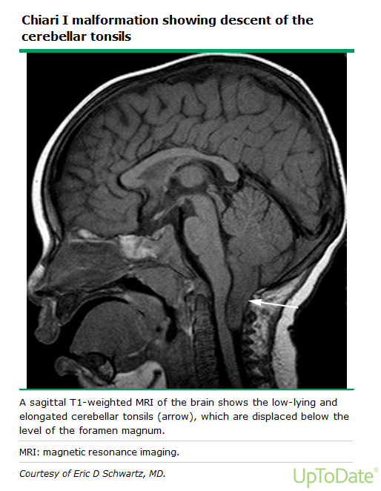
Chiari Malformation
13 year old boy- presents with new onset Migraine headache with vomiting daily.
What is your next step?

Slide 7
Migraines
Most common acute and recurrent headache syndrome in children
Severe headache accompanied by nausea , vomiting, photophobia, phonophobia, and abdominal pain relieved by sleep.
Do you need an MRI?
Notes:
Neuroimaging is usually not warranted in patients whose history is consistent with migraine and who have a normal neurologic examination.
MRI is generally preferable if needed b/c of decrease risk of radiation.

